Slide 1
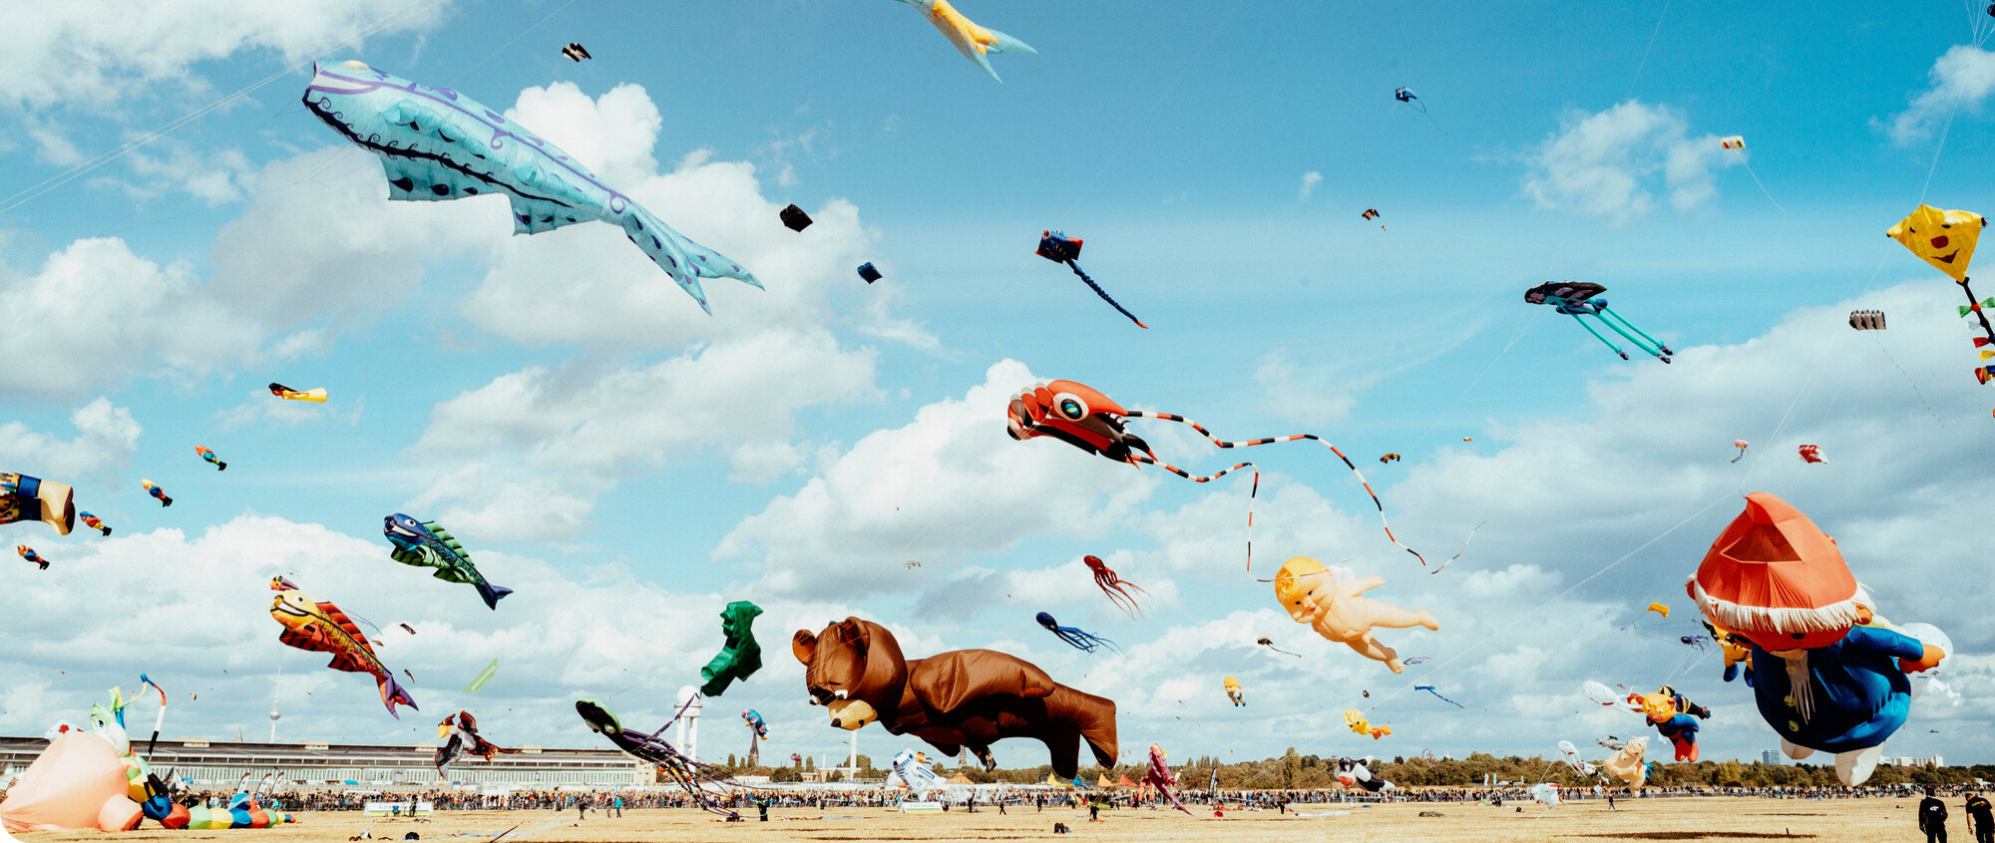
How to Docker
Tech RO
April 2022

Slide 2
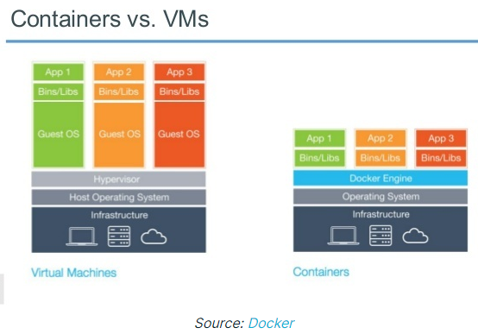
Docker | Virtual Machines vs Docker
• It does not replace a VM
• lightweight
• more suitable for microservices
Notes:
During this 'Scrum by the book' and / or Kanban execution (this and next chapter), the PO, Chapter Leads and the Scrum Master and / or Agile Coach form an active coalition to continuously monitor and improve the working of a Squad. This coalition is called the POCLAC. When the Squad is working Kanban and does not have a Product Owner, than a Squad-member will represent the Squad.
The POCLAC is a coalition, which usually meets once a week or once a Sprint, at which the PO, Chapter Lead(s) (and if considered necessary Scrum Master) and Agile Coach of each Squad discuss the developments in a Squad. POCLAC meetings are a way to work on optimum Squad capacity and competency development. As the meetings are at Squad level, they may involve more than one CL.
During the POCLAC:
The PO is owner of functional leadership, the what and the why
The Scrum Master and / or Agile Coach is owner of turning
Squads into High-Performing Teams, for continual improvement and for safeguarding the agile values
The Chapter Lead is owner of the growth of individual chapter (and therefore Squad) members, for ongoing professionalization
Together, they ensure that Tribes/Squads are qualitatively properly staffed

Slide 3
Docker| Image vs Container
Docker image
Useful commands:
= file that represents a packaged application with all the dependencies needed to run correctly
docker image ls / docker images
Docker pull <image>:<version>
docker ps –> to see running containers
Docker ps –a →to see all containers in all stages
docker pause <container id>
docker stop/start <container id>
docker container rm <container id> ->deletion of a container
Docker network ls -> to see networks
Docker network inspect <networkName>
- Docker images are mainly available on Docker HUB
- Images can also be created and stored locally via Dockerfile
- Once created is READ-ONLY
Docker Container
=its just an instance of in image
From an image you can spin up multiple containers
Containers are isolated from each other
Containers can be paused
Non-persistent data !
Notes:
During this 'Scrum by the book' and / or Kanban execution (this and next chapter), the PO, Chapter Leads and the Scrum Master and / or Agile Coach form an active coalition to continuously monitor and improve the working of a Squad. This coalition is called the POCLAC. When the Squad is working Kanban and does not have a Product Owner, than a Squad-member will represent the Squad.
The POCLAC is a coalition, which usually meets once a week or once a Sprint, at which the PO, Chapter Lead(s) (and if considered necessary Scrum Master) and Agile Coach of each Squad discuss the developments in a Squad. POCLAC meetings are a way to work on optimum Squad capacity and competency development. As the meetings are at Squad level, they may involve more than one CL.
During the POCLAC:
The PO is owner of functional leadership, the what and the why
The Scrum Master and / or Agile Coach is owner of turning
Squads into High-Performing Teams, for continual improvement and for safeguarding the agile values
The Chapter Lead is owner of the growth of individual chapter (and therefore Squad) members, for ongoing professionalization
Together, they ensure that Tribes/Squads are qualitatively properly staffed
Agenda questions
Performance
What is the story cycle time and can this be improved
What is the predictability ratio and can this be improved
Did the squad managed to delivery the sprint goals
Is the purpose of the squad still applicable
How is the demand for coming 6 months?
Is the squad organized around the right purpose?
Skills:
Can you do the work on the backlog with the current skills in the squad?
How about looking forward (6 months): which skills should be developed or added?
Behavior:
Coaching demand: Did any demand for coaching come up from the retrospective or individual feedback, which is structural and that has not been acted upon.
What do we think of the behavior of the squad? i.e. Are they showing Orange Code behavior or Agile mindset? Does this need action? and if yes, from who?
Is the squad also working on improving their selves
Do the people speak up
Way of working
Is the squad able to improve their way of working
Is the squad able to be more in-depended?
Tips & Tops:
How are the individual squad members doing? And what about the squad as a whole? Both the positive (tops) and improvements (tips).

Slide 4
Docker Installation| Windows & Linux
Windows restrictions:
Docker toolbox deprecated in 2020 so no official way to install on W7/8/ or W10 below build1909
https://docs.docker.com/desktop/windows/install/ - download / double-click / install
Linux Install:
https://docs.docker.com/desktop/linux/install/
Depends on distro or if interested in Docker desktop.
Either use sudo, or add docker usergroup as root : https://docs.docker.com/engine/install/linux-postinstall/

Slide 5
LAB 1.

Slide 6
Lab1 | Hello ? Tomcat ?
Docker hub is the main online and official docker repository:
https://hub.docker.com/
1.1 Pulling a hello-word container and image:
Docker pull –help
Docker run hello-word
1.2 Spinning a new container from the same image
Docker run –d –it --name ContainerName
1.3 Container with Ubuntu / Apache /tomcat
Docker run –d –it –name=Tomcat1 tomcat
Docker exec –it Tomcat1 ->to connect to container
As a reminder, for how to pull a specific image and on how to run it, please visit its official page on docker hubs, and all instructions are there.
“Sometimes finding the right commands for your docker takes trial and error.” – Said by a random Docker user.

Slide 7


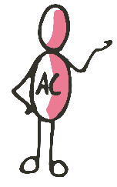

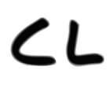

Answer | Same network
Containers are stripped down and have nothing more than the needed requirements for that particular required service.
Example of how to install one network tool on a container:
apt-get update
apt-get install iputils-ping

Slide 8
Docker | More than one way
Docker can be managed in multiple ways, either via its own proprietary GUI interface, or via the CLI, and the CLI being the most powerful and rich in options way to manage your docker images/containers.
Besides the two above options, there are multiple ways to mange your docker via a container like PORTAINER.
For all details regarding PORTAINER please check on its official Docker hubs portainer page:
https://hub.docker.com/r/portainer/portainer-ce
Commands:
docker pull portainer/portainer-ce
docker run -d -p 8000:8000 -p 9443:9443 --name portainer --restart=always -v /var/run/docker.sock:/var/run/docker.sock -v portainer_data:/data portainer/portainer-ce:2.9.3
Notes:
POCLAC Q’s
Purpuse/ Okr/ QBR
What is the contribution of the squad to the tribe goals?
Where lies the challenge for the squad? Speed or impact and how can we help as chapter leads?
How is the aligning of the roadmap with the stakeholders?
How is collaboration with the stakeholders?
Autonomy
How is the way of working and how can we help to improve it?
How is the team spirit, can we help to improve it?
How are the RoE’s of the team, their independency, their team happiness/team moral, their performance? Their continuous improvement focus? How can we help?
What are examples of waist the team works on?
What are needs of the team that can be helped on?
Mastery
Do the team members have all the needed skills in the squad ?
How are the available skills used in the squad?

